Slide 1

3D Inspection Rover
11-03-2022 20:11:11
Team 8
Final Presentation
Sponsor:
Kevin Nowka
TA:
Eric Robles
Team Members:
Chris Dumont
Dalton Hines
Felipe Villegas
Celeste Waters

Slide 2
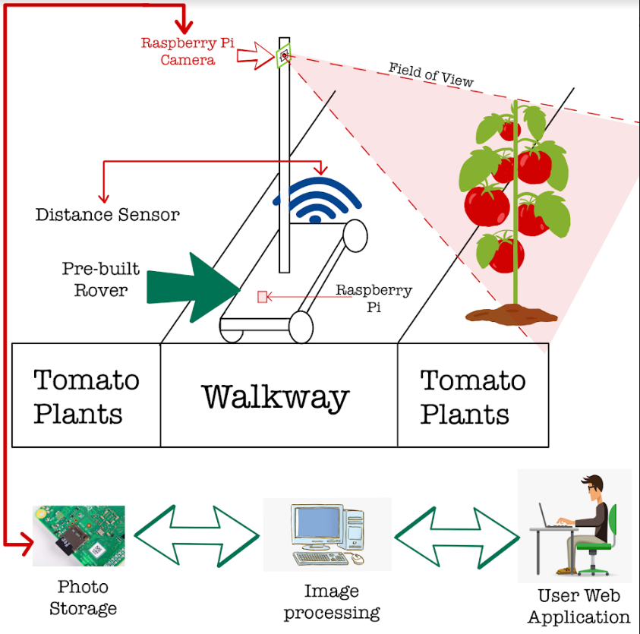
Project Summary
The Problem Is:
Tomato Classification in its current state takes too long
The Solution Is:
Create a rover that classifies the tomatoes autonomously
Send this data to a database/website that displays yield for the farmer
Requirements:
ML Algorithm is 65%+ accurate
Confidence rating of 75%+
Rover does not miss any plants

Slide 3
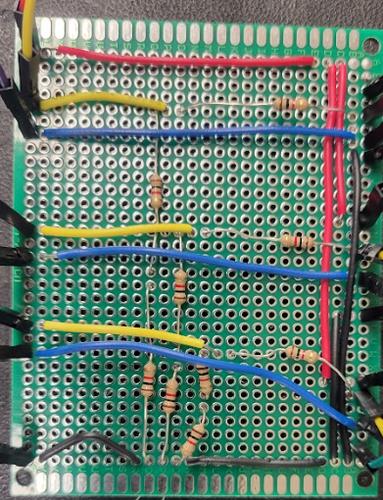
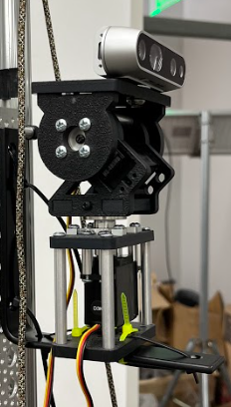
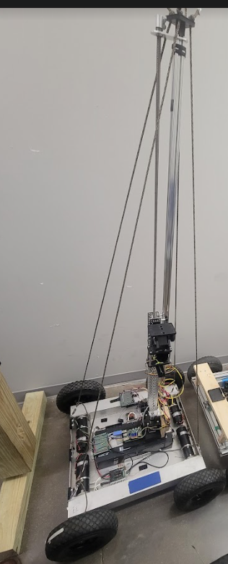
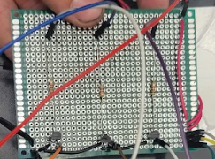
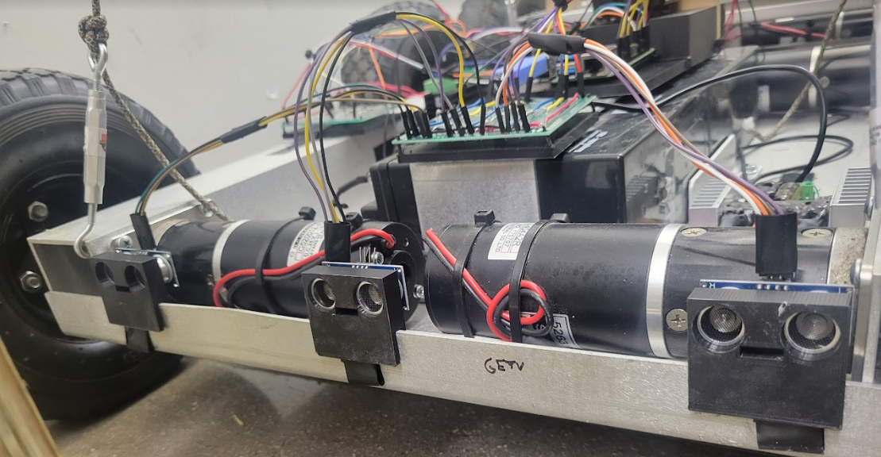
Mechanical Integration
Sensor Circuitry
Camera/Gimbal Mounted
Mast Circuitry
Camera and Gimbal Mounted
Circuitry for sensors, gimbal, and mast
Distance Sensors Mounted
Entire Rover Assembled
Notes:
Picture (or collection of pictures) or drawing of system
Major components labeled
Show how user connects (ui screens, pictures, etc)
Label major connections/interfaces

Slide 4
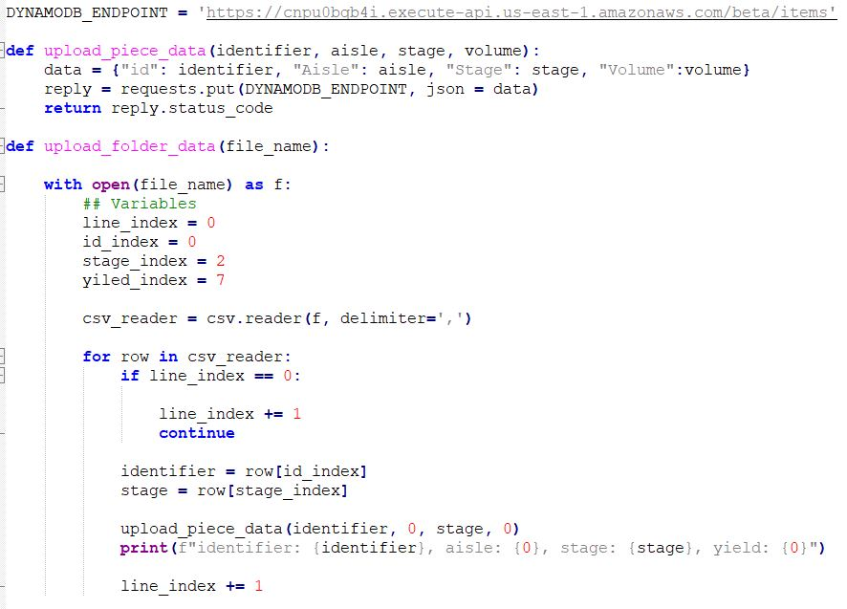
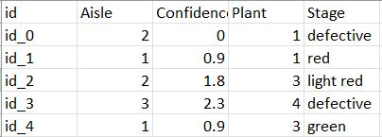
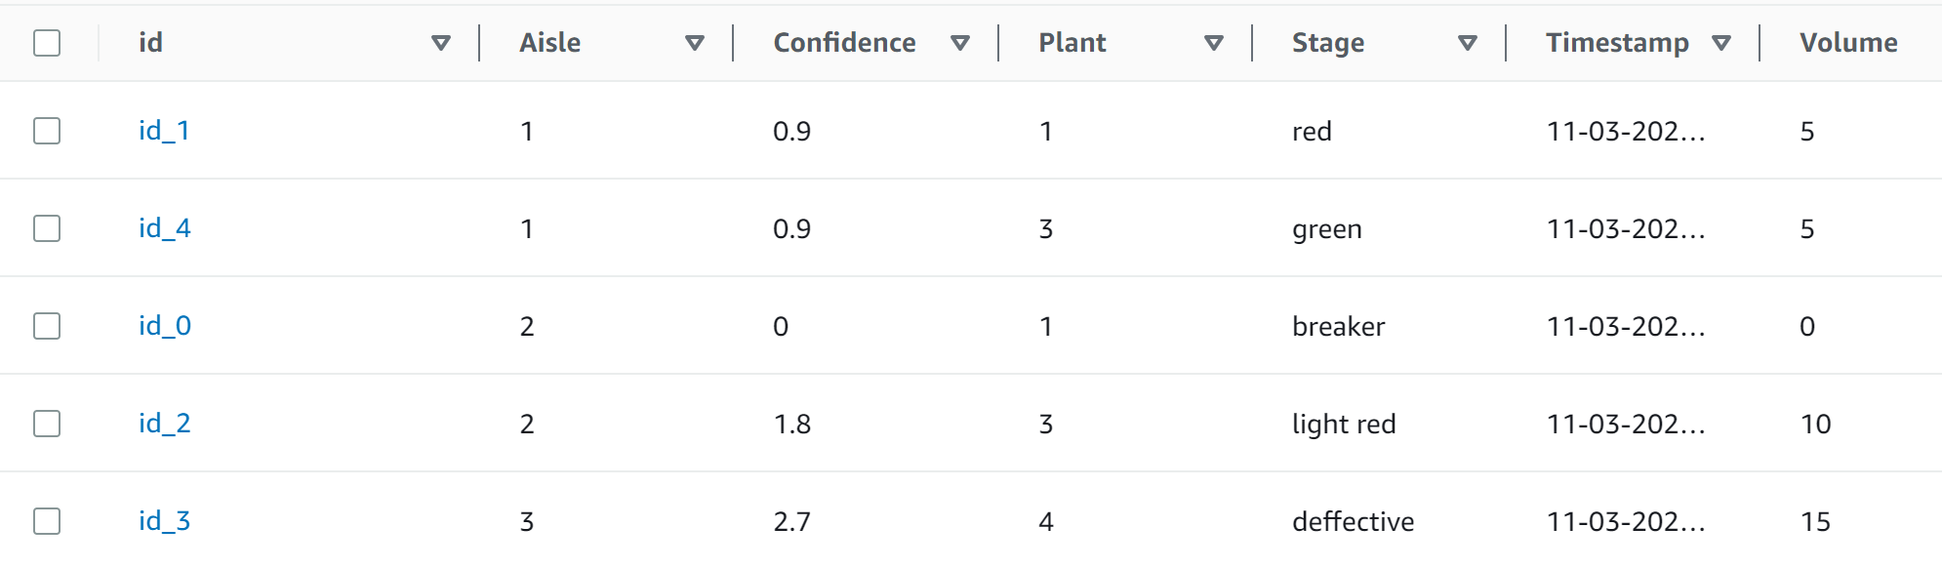
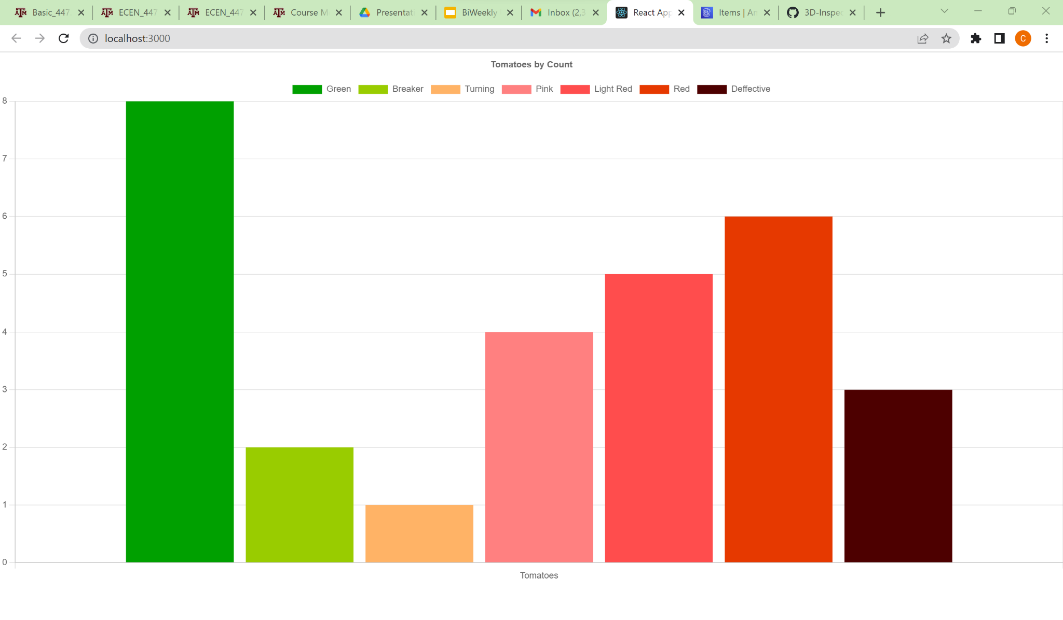
Digital Integration
Call to endpoint
Dynamo Db Table
Web page graph

Slide 5
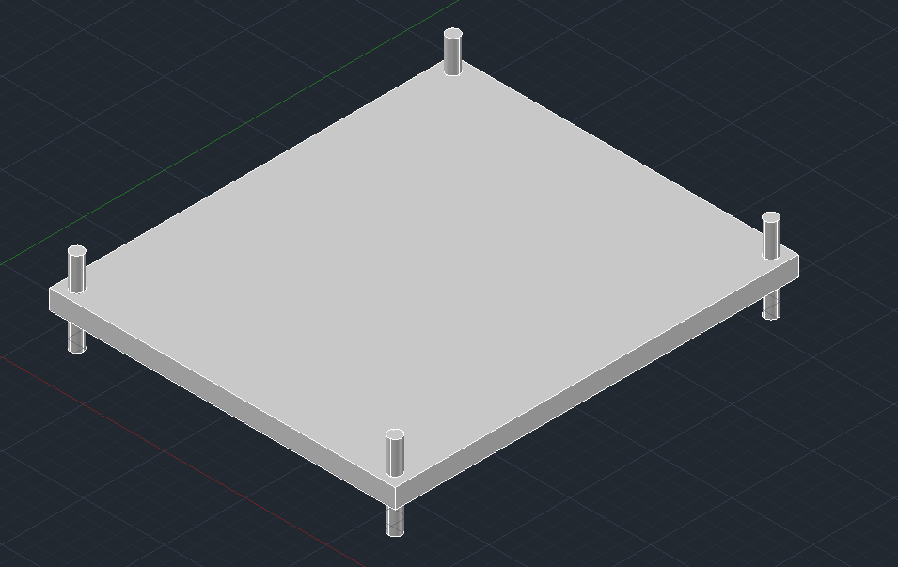
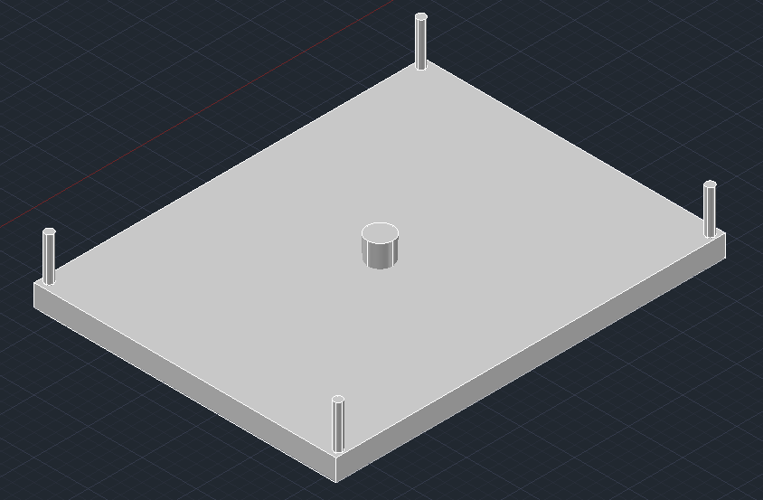
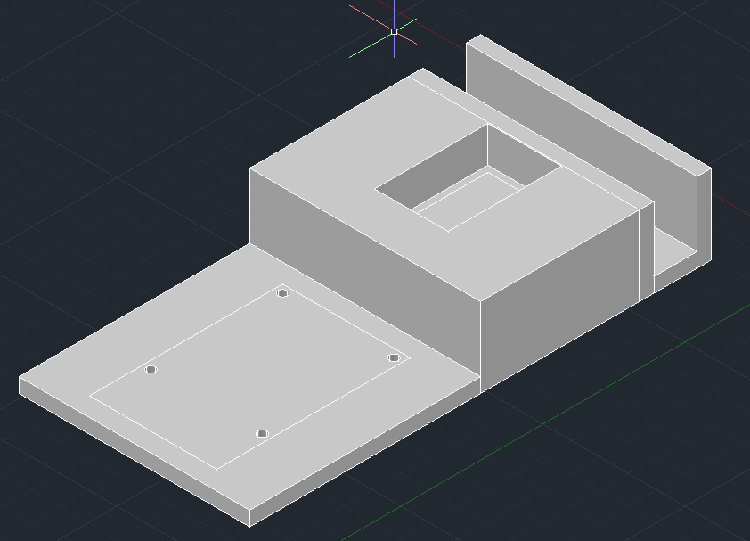
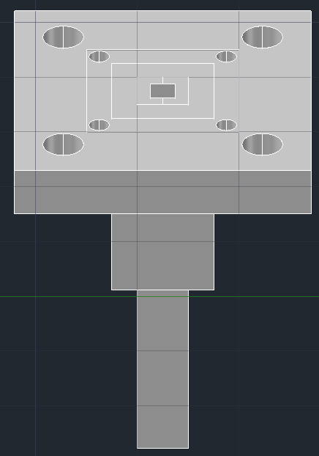
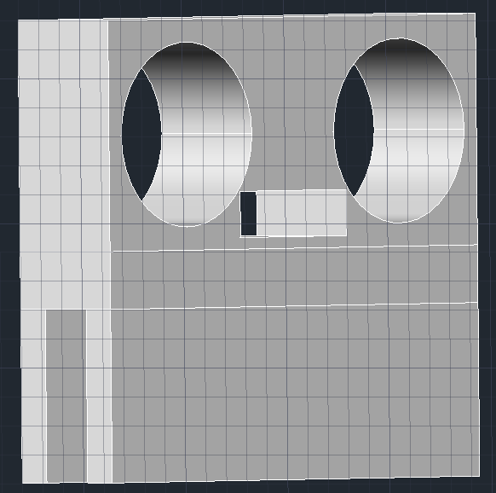
Design Accomplishments
Chris Dumont
3D printed all parts for mounting hardware to rover
Had to reprint the sensor mounts 3x
Pi Mount
Proto-Board Mount
Mast Mount
Tie Down Mast
Distance Sensor Mount

Slide 6
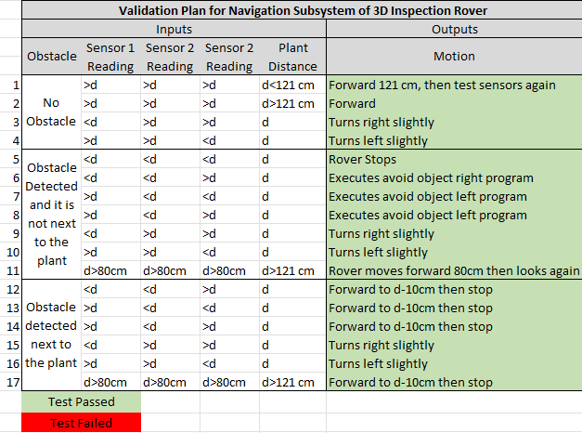
Software Accomplishments
Chris Dumont
Rover navigates as expected
All sensors read accurately for distances required
Fail as expected

Slide 7
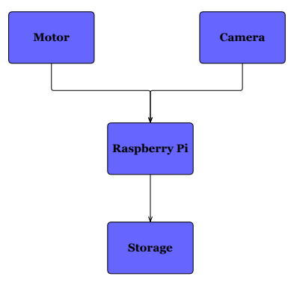
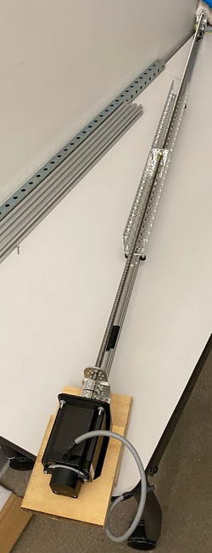
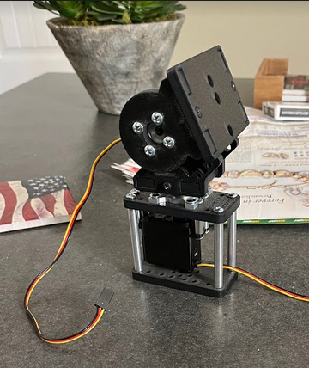
Design Accomplishments
Dalton Hines
Research and development of gimbal
Research and development of mast
Stepper motor/driver circuit design
Image capturing and saving
Camera positioning program designed

Slide 8
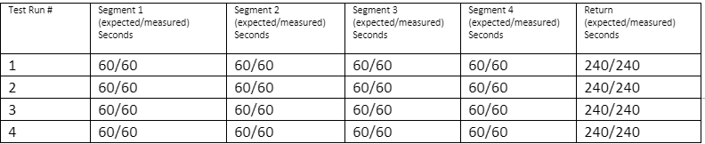
Design Validation
Dalton Hines
Mast movement validation for runtime

Slide 9
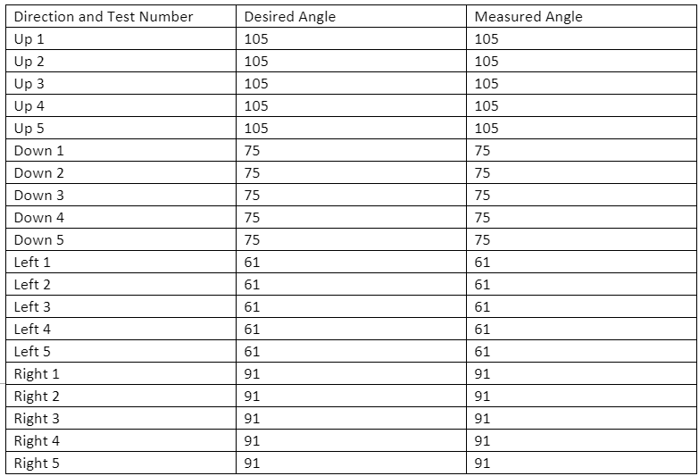
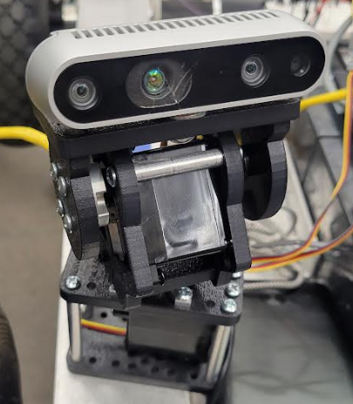
Design Validation
Dalton Hines
Angle validation of gimbal pan/tilt

Slide 10
Design Accomplishments
Felipe Villegas
Model to detect tomatoes in an image
Accomplished with YOLOv4
Model to determine if a tomato is defective or healthy
Accomplished using CNN model
Model to determine the ripeness stage of a tomato
Accomplished using CNN model
Models converted to TF-lite models for running on edge devices
Volume yield estimation program process ongoing

Slide 11
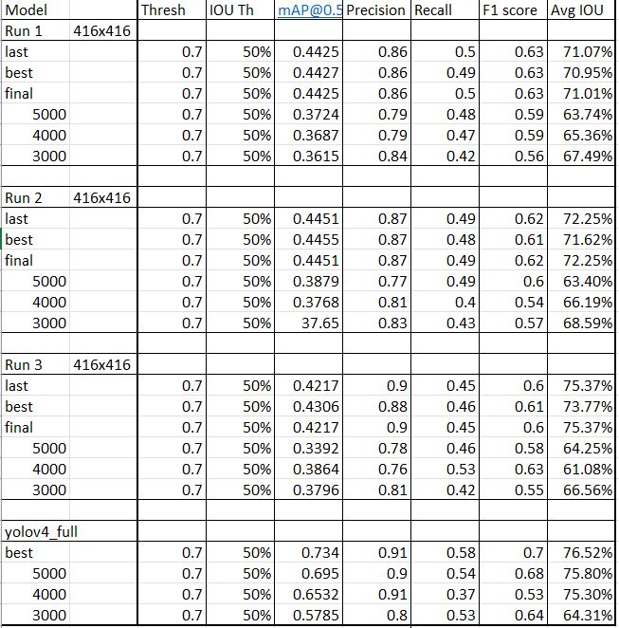
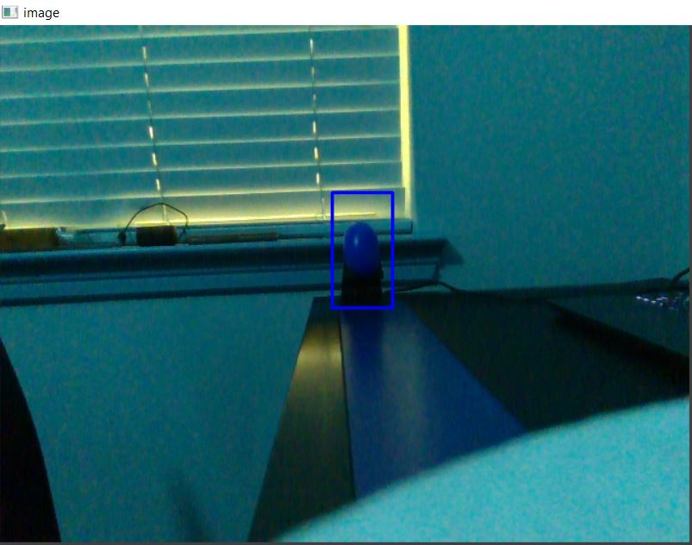
Validation - Tomato Detection Model
Felipe Villegas
Precision is greater than 70% for all models
Average IOU greater than 70% for several models
mAP for IOU at 50% is around 45% for YOLOv4-lite models, and 73% for YOLOv4 model

Slide 12
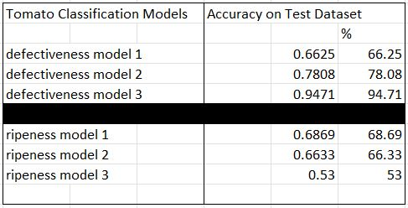
Validation - Tomato Classification Model
Felipe Villegas
Highest defectiveness model accuracy is 94.71% on an oversampled dataset
Highest ripeness model accuracy is 68.69% on an oversampled dataset

Slide 13
Design Accomplishments
Celeste Waters
Design:
React framework for web page development (Client-Side)
Progressive Web Application (PWA)
AWS DynamoDb (Server-Side)
Backend as a Service (BaaS)
Lambda AWS
runs code in response to posting data to the database

Slide 14
Design Validation
Set up AWS API gateway
Made API call via endpoint
Lambda function posts to the database

Slide 15
Design Validation
Celeste Waters
Data that was sent to database is correctly displaying in chart below

Slide 16
Integrated System Results
Rover Navigates from plant to plant accurately
Then moves camera up mast to designated height
Camera then communicates with ML algorithm and classifies all tomatoes in view
Steps 2-3 repeat for all heights, before navigating to next plant
At end of day rover uploads all information to database
From the database, the web page displays a helpful graph of the tomatoes

Slide 17
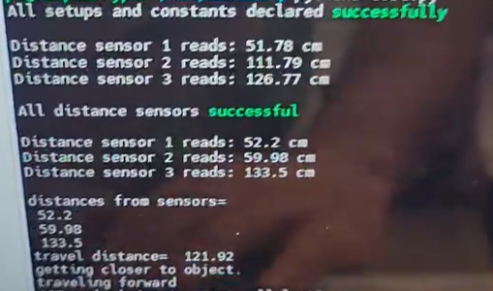
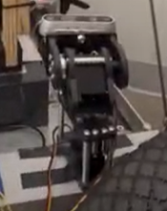
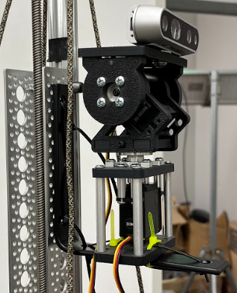
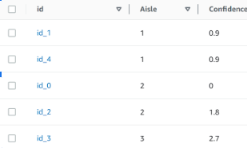
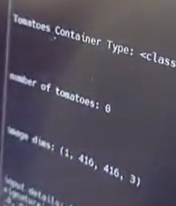
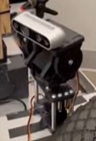
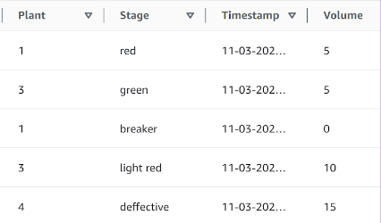
Integrated System Results
2-4
1.
5.
6.

Slide 18
Conclusions
Issues/Changes
Rover was originally supposed to use the camera for knowing when to stop.
Now the greenhouse is a fixed shape
System was wanted to be waterproof, but won’t be due to time constraints and design limitations
Volume estimation methodology change
Current Status
Navigation is operating as intended
Sensors operational
Camera positioning operational
ML able to locate and classify tomatoes
Website displays accurate graph
Notes:
Current status (eg. integration/test/validation complete; Integration complete, but BT comm not fully validated; Repeating testing for replacement PCB, integration/validation to be completed in 1 week)

Slide 19
Questions?

